Slide 1

Exception Null

Slide 2
Progress
Grow your skills.
Monitor your progress and unlock badges! Embark on challenges designed to not only help you land a job, but excel at it!

Slide 3
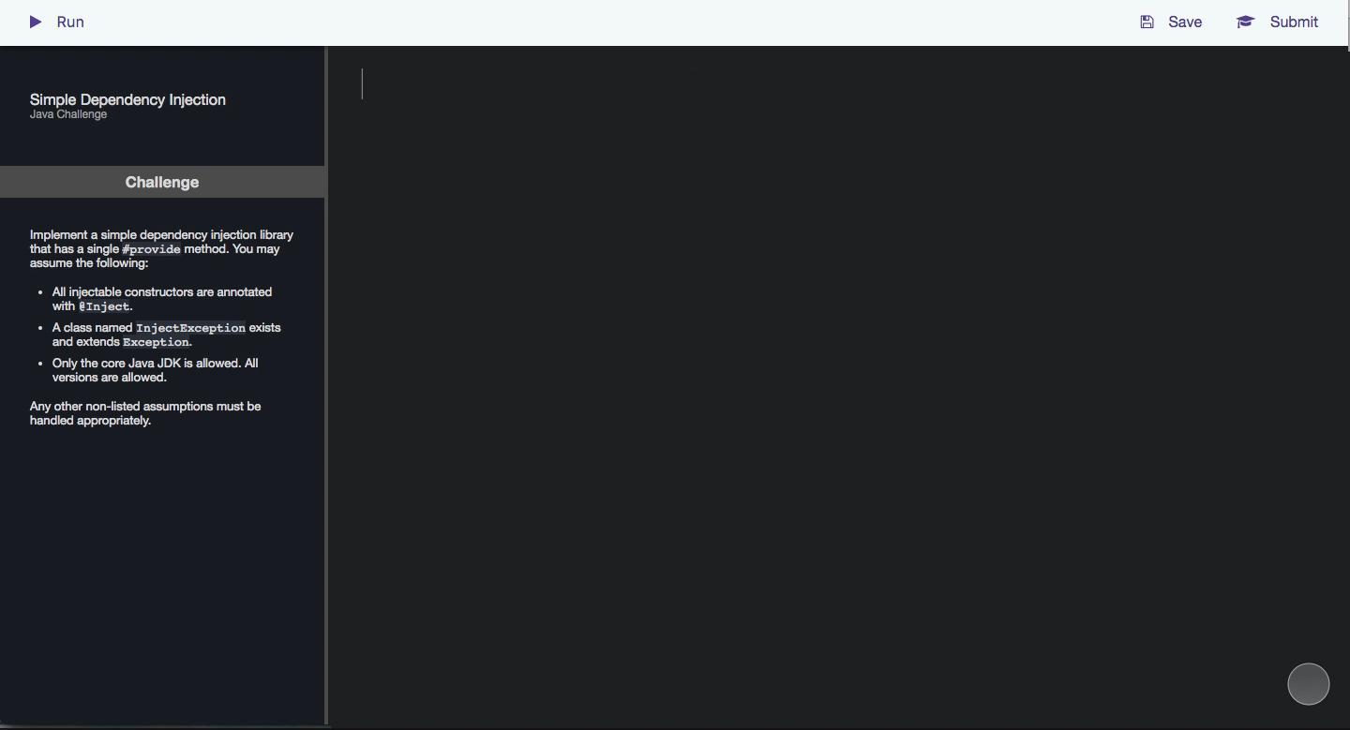
Intuitive Practices
Have fun while challenging your friends.
Monitor your progress and unlock badges! Embark on challenges designed to not only help you land a job, but excel at it!

Slide 4


Receive Feedback
Acknowledge your strengths and weaknesses.
As a premium user, you will get personal, professional feedback on your work so you know exactly how to focus your efforts!

Slide 5
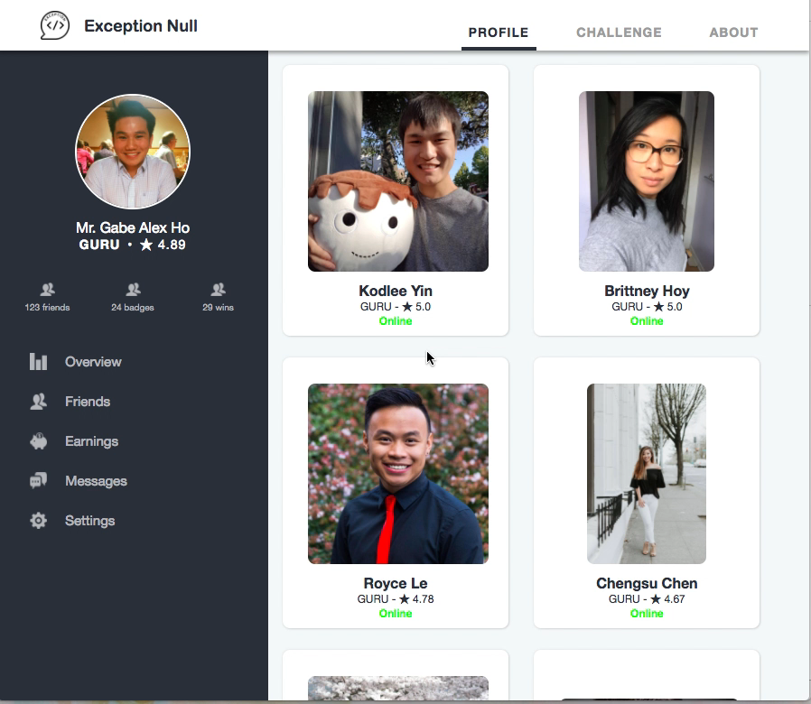
Building a Community
Be part of the conversation. Join discussions. Interact with seniors, peers, and even those just starting out!

Slide 6

Get Hired
We partner with companies looking to hire top talent in Tech. Challenges on our platform are geared towards meeting the specific needs of the industry and prepare you to jump right in!

Slide 7


Paying it Forward
When you become a premium user, a part of the proceeds goes towards helping someone less fortunate get an opportunity to learn a new skill. Not only do you get better at coding, you also help change the lives of others!

